Slide 1
Polymorphism
Course Code:
Course Title: Object Oriented Programming -1(JAVA)
Dept. of Computer Science
Faculty of Science and Technology
Lecturer No: |  | Week No: |  | Semester:
Lecturer: | Sifat Rahman Ahona, ahona@aiub.edu

Slide 2
Lecture Outline
Polymorphism
Method Overloading
Method Overriding
Constructor Overloading
Polymorphic Behavior of Objects

Slide 3
Polymorphism
Definition of Polymorphism
It means ‘Different Forms of the Same Thing’.
In other words ‘One Name, Different Forms’.
Real Life Example:
Imagine, you and your friend are walking inside your MidTerm exam room. Just before entering the room, your friend is saying, “You are my best friend, brother. Don’t worry about the exam. I got your back. I’ll slide my script a bit right from me, all you need to do is to take a peek and write.”

Slide 4
Polymorphism
Example of Polymorphism
Now, during the exam, no matter how much you poke your friend, your friend is neither responding nor sliding the script. You are really really upset with your friend.
And after the exam, your friend is like, “I’m sorry, brother. Please forgive me. I’m your best friend. Let me give you a treat. Lets have some fun in Canteen.”

Slide 5
Example of Polymorphism
What do you learn from the story?
Before the Exam: Your Friend is a Friend.
During The Exam: Your Friend acts Like Enemy.
After The Exam: Your Friend is a Friend Again.
The story highlights on different forms of your friend. Sometimes he is like a friend, sometimes he is like an enemy.

Slide 6
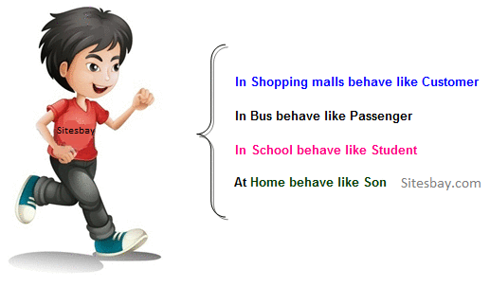
Example of Polymorphism

Slide 7
Example of Polymorphism
Let’s imagine another scenario, it is a very usual case that in a class (section) there are more than one student having the same name. But their work/activities are different. One may get scholarship, the other might be in probation.
So, in real life, we always see polymorphic behavior of humans.
In Programming the polymorphic behavior might be with methods, Constructors and Objects.
Method Overloading.
Method Overriding.
Constructor Overloading.
Polymorphic Behavior of Objects.

Slide 8
Method Overloading
As the name suggests, it happens among methods. There are some conditions of method overloading. If and only If these conditions are met, we can say that there are method overloading among those methods.
These conditions are:
Methods MUST be in same class.
Method Name MUST be same.
Method Parameter MUST be different.
Method Return Type may or may not be same.

Slide 9
Method Overloading - Example
public class MyClass{
public void add( ){. . .}
public void add(int a) {. . .}
public void add(int a, int b) {. . .}
public void add(double a, double b) {. . .}
public void add(int a, double b) {. . .}
public void add(double a, int b) {. . .}
//public int add(int a) {. . .}
}
public class YourClass{
public void add( ){. . .}
public void add(int a) {. . .}
}

Slide 10
Method Overloading - Example
public class MyClass{
public void add( ){. . .}
//public void add(int a) {. . .}
public void add(int a, int b) {. . .}
public void add(double a, double b) {. . .}
public void add(int a, double b) {. . .}
public void add(double a, int b) {. . .}
public int add(int a) {. . .}
}
public class YourClass{
public void add( ){. . .}
public void add(int a) {. . .}
}

Slide 11
Method Overriding
Again, it happens among methods. There are some conditions of method overriding. If and only If these conditions are met, we can say that there are method overriding among those methods.
These conditions are:
Methods MUST be in two different classes.
There MUST be inheritance between the two classes.
Method Name MUST be same.
Method Parameter MUST be same.
Method Return Type MUST be same.

Slide 12
Method Overriding - Example
public class Alpha{
public void show( ){. . .}
public void print( ){. . .}
}
public class Bravo extends Alpha{
public void show( ){. . .}
public void print(int a){. . .}
}
public class Charlie extends Alpha{
public void show(int a){. . .}
public void print( ){. . .}
}
public class Delta{
public void show( ){. . .}
public void print( ){. . .}
}

Slide 13
Constructor Overloading
As the name suggests, it happens among Constructors. There are some conditions of constructor overloading. If and only If these conditions are met, we can say that there is constructor overloading in that class. These conditions are:
Constructors MUST be of same class.
Constructor Parameter MUST be different.

Slide 14
Constructor Overloading - Example
Just look at all the classes we have written this far. All of them has two constructors. One is Empty and the other is Parameterized.
Do you remember, how many constructors the class String has?

Slide 15
Polymorphic Behaviour of Objects
Before starting, let us go back to the statement:
Box b = new Box( );
Where is the Object?
Constructor Call for Object Creation
Class Name
Object Name
New keyword for memory allocation

Slide 16
Polymorphic Behaviour of Objects
Box b = new Box( );
Where did we hear the term ‘Object Reference before’?
Box b1; //Object Reference Declaration
b1 = new Box( ); //Object Creation
Box b2 = new Box( ); //Object Creation
new Box( ); //Anonymous Object
Class Name
Object Reference
Object

Slide 17
Polymorphic Behaviour of Objects
String s1 = new String (“Java”);
s1 = new String(“OOP1”);
What did we call this s1?
Reference
String pool
s1 Java

Slide 18
Polymorphic Behaviour of Objects
What is Anonymous Object?
An Object without any Name
new Box( );
So, Anonymous object can be used if and only if the object is required for just one time.
length | 1.5
width | 0.0
height | 0.0
new Box( ).setLength(1.5);
new Box( ).setWidth(1.2);
length | 0.0
width | 1.2
height | 0.0

Slide 19
Polymorphic Behaviour of Objects
According to the Polymorphic Behavior of Objects, An Object Reference of Parent Class can hold an Object of a Child Class.
Before going for an example, let’s assume the following Inheritance Tree:
Person
Employee
Student
Faculty

Slide 20
Polymorphic Behaviour of Objects
From the Inheritance tree, we can write the following statements:
Person p = new Person( );
Employee e = new Employee( );
Faculty f = new Faculty( );
Student s = new Student( );
Person
According to polymorphic behavior of objects, we can also write the following statements:
Person p1 = new Employee( );
Person p2 = new Faculty( );
Person p3 = new Student( );
Employee e1 = new Faculty( );
But we can not write the following statements:
Employee e2 = new Student( );
Student s2 = new Faculty( );
Employee
Student
√
Faculty
√
X

Slide 21
Polymorphic Behaviour of Objects
Why is it necessary?
Lets have a look on the following class diagrams:

Slide 22
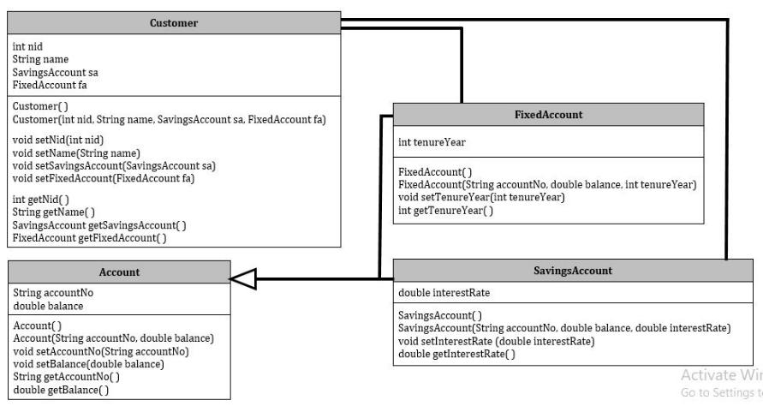
Polymorphic Behaviour of Objects

Slide 23
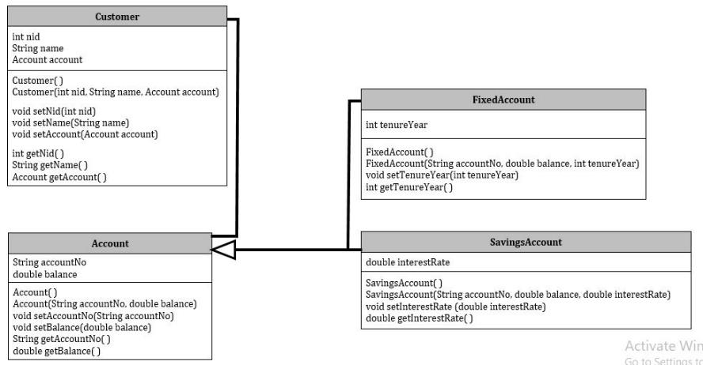
Polymorphic Behaviour of Objects

Slide 24
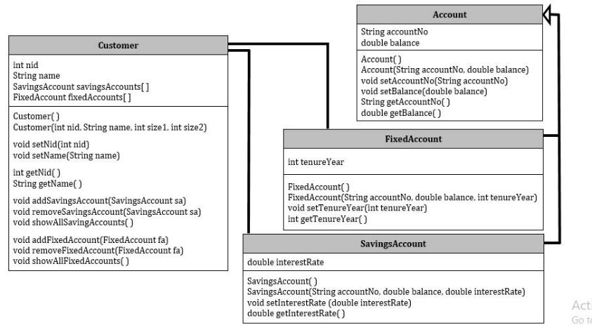
Polymorphic Behaviour of Objects

Slide 25
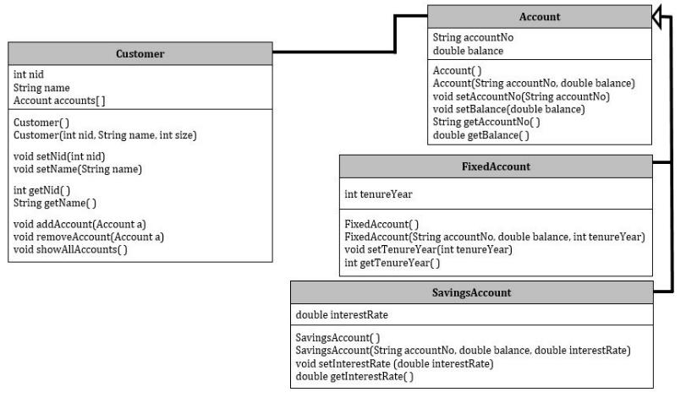
Polymorphic Behaviour of Objects

Slide 26
Example of Polymorphism
accounts = new Account [5];
Account a1 = new SavingsAccount(1111, 2500.0, 3.75);
Account a2 = new FixedAccount(2222, 3500.0, 10);
accounts[0] = a1;
accounts[1] = a2;
accountNo | 1111
balance | 2500.0
interestRate | 3.75
accountNo | 2222
balance | 3500.0
tenureYear | 10
 |  | null | null | null
0 | 1 | 2 | 3 | 4

Slide 27
Dynamic Method Dispatch
Dynamic Method Dispatch:
It is the mechanism by which a call to an overridden method is resolved at run time, rather than compile time.
Through Dynamic Method Dispatch Java implements
run-time polymorphism.

Slide 28
Polymorphism
In the previous slides, the two objects are defined to have the same type at compile time: BankAccount
However, the types of objects they are referring to at runtime are different
What happens when the withdraw method is invoked on each object?
anAccount refers to an instance of BankAccount. Therefore, the withdraw method defined in BankAccount is invoked.
account1 refers to an instance of OverdraftAccount. Therefore, the withdraw method defined in OverdraftAccount is invoked.
Polymorphism is: The method being invoked on an object is determined AT RUNTIME and is based on the type of the object receiving the message. (Runtime Polymorphism)
Through Method Overriding we achieve runtime polymorphism

Slide 29
Books
1. Java Complete Reference, 7th Edition, By Herbert Schildt.
2. A Programmer's Guide to Java SE 8 Oracle Certified Associate, Khalid A. MughalRolf W. Rasmussen
3. Java How to Program Java, 9th Edition, By Deitel and Deitel.
4. The Java Language Specification, By J. Gosling, B. Joy, G. Steele, G.Bracha and A. Buckley
5. Introduction to Programming Using Java, 6th Edition, By David j. Eck
6. Head First Java, By Kathy Sierra and Bert Bates

Slide 30
References
1. 1. Java Complete Reference, 7th Edition, By Herbert Schildt.
2. A Programmer's Guide to Java SE 8 Oracle Certified Associate, Khalid A. MughalRolf W. Rasmussen
2. The Java Tutorials. http://docs.oracle.com/javase/tutorial/

